Slide 1


Pacific Cascade MS PTSA
Membership Meeting
September 20, 2018

Slide 2

Agenda
Secretary’s Report
School Leadership Report
Officers’ and Directors’ Reports
New Business: Enrichment Grants

Slide 3
Secretary’s Report
Approval of minutes from May 24, 2018 membership meeting

Slide 4
School Leadership Report
Report from Asst. Principal Casey Stookey

Slide 5
Presidents’ Report
District / PTSA Council News:
  McCleary money (approx. $38 million) has funded 160 new positions in the ISD and allowed class size reductions
  New, 4-year collective bargaining agreement has been adopted; morale is very high
  Feasibility work has started on Volpe site on Iss.-Pine Lake Road (16th elementary), construction scheduled to start next spring/summer for a 2020 Fall opening
  New Admin Building work is underway but behind schedule
  ISD Enrollment is down for the 1st time in 25-30 years

Slide 6
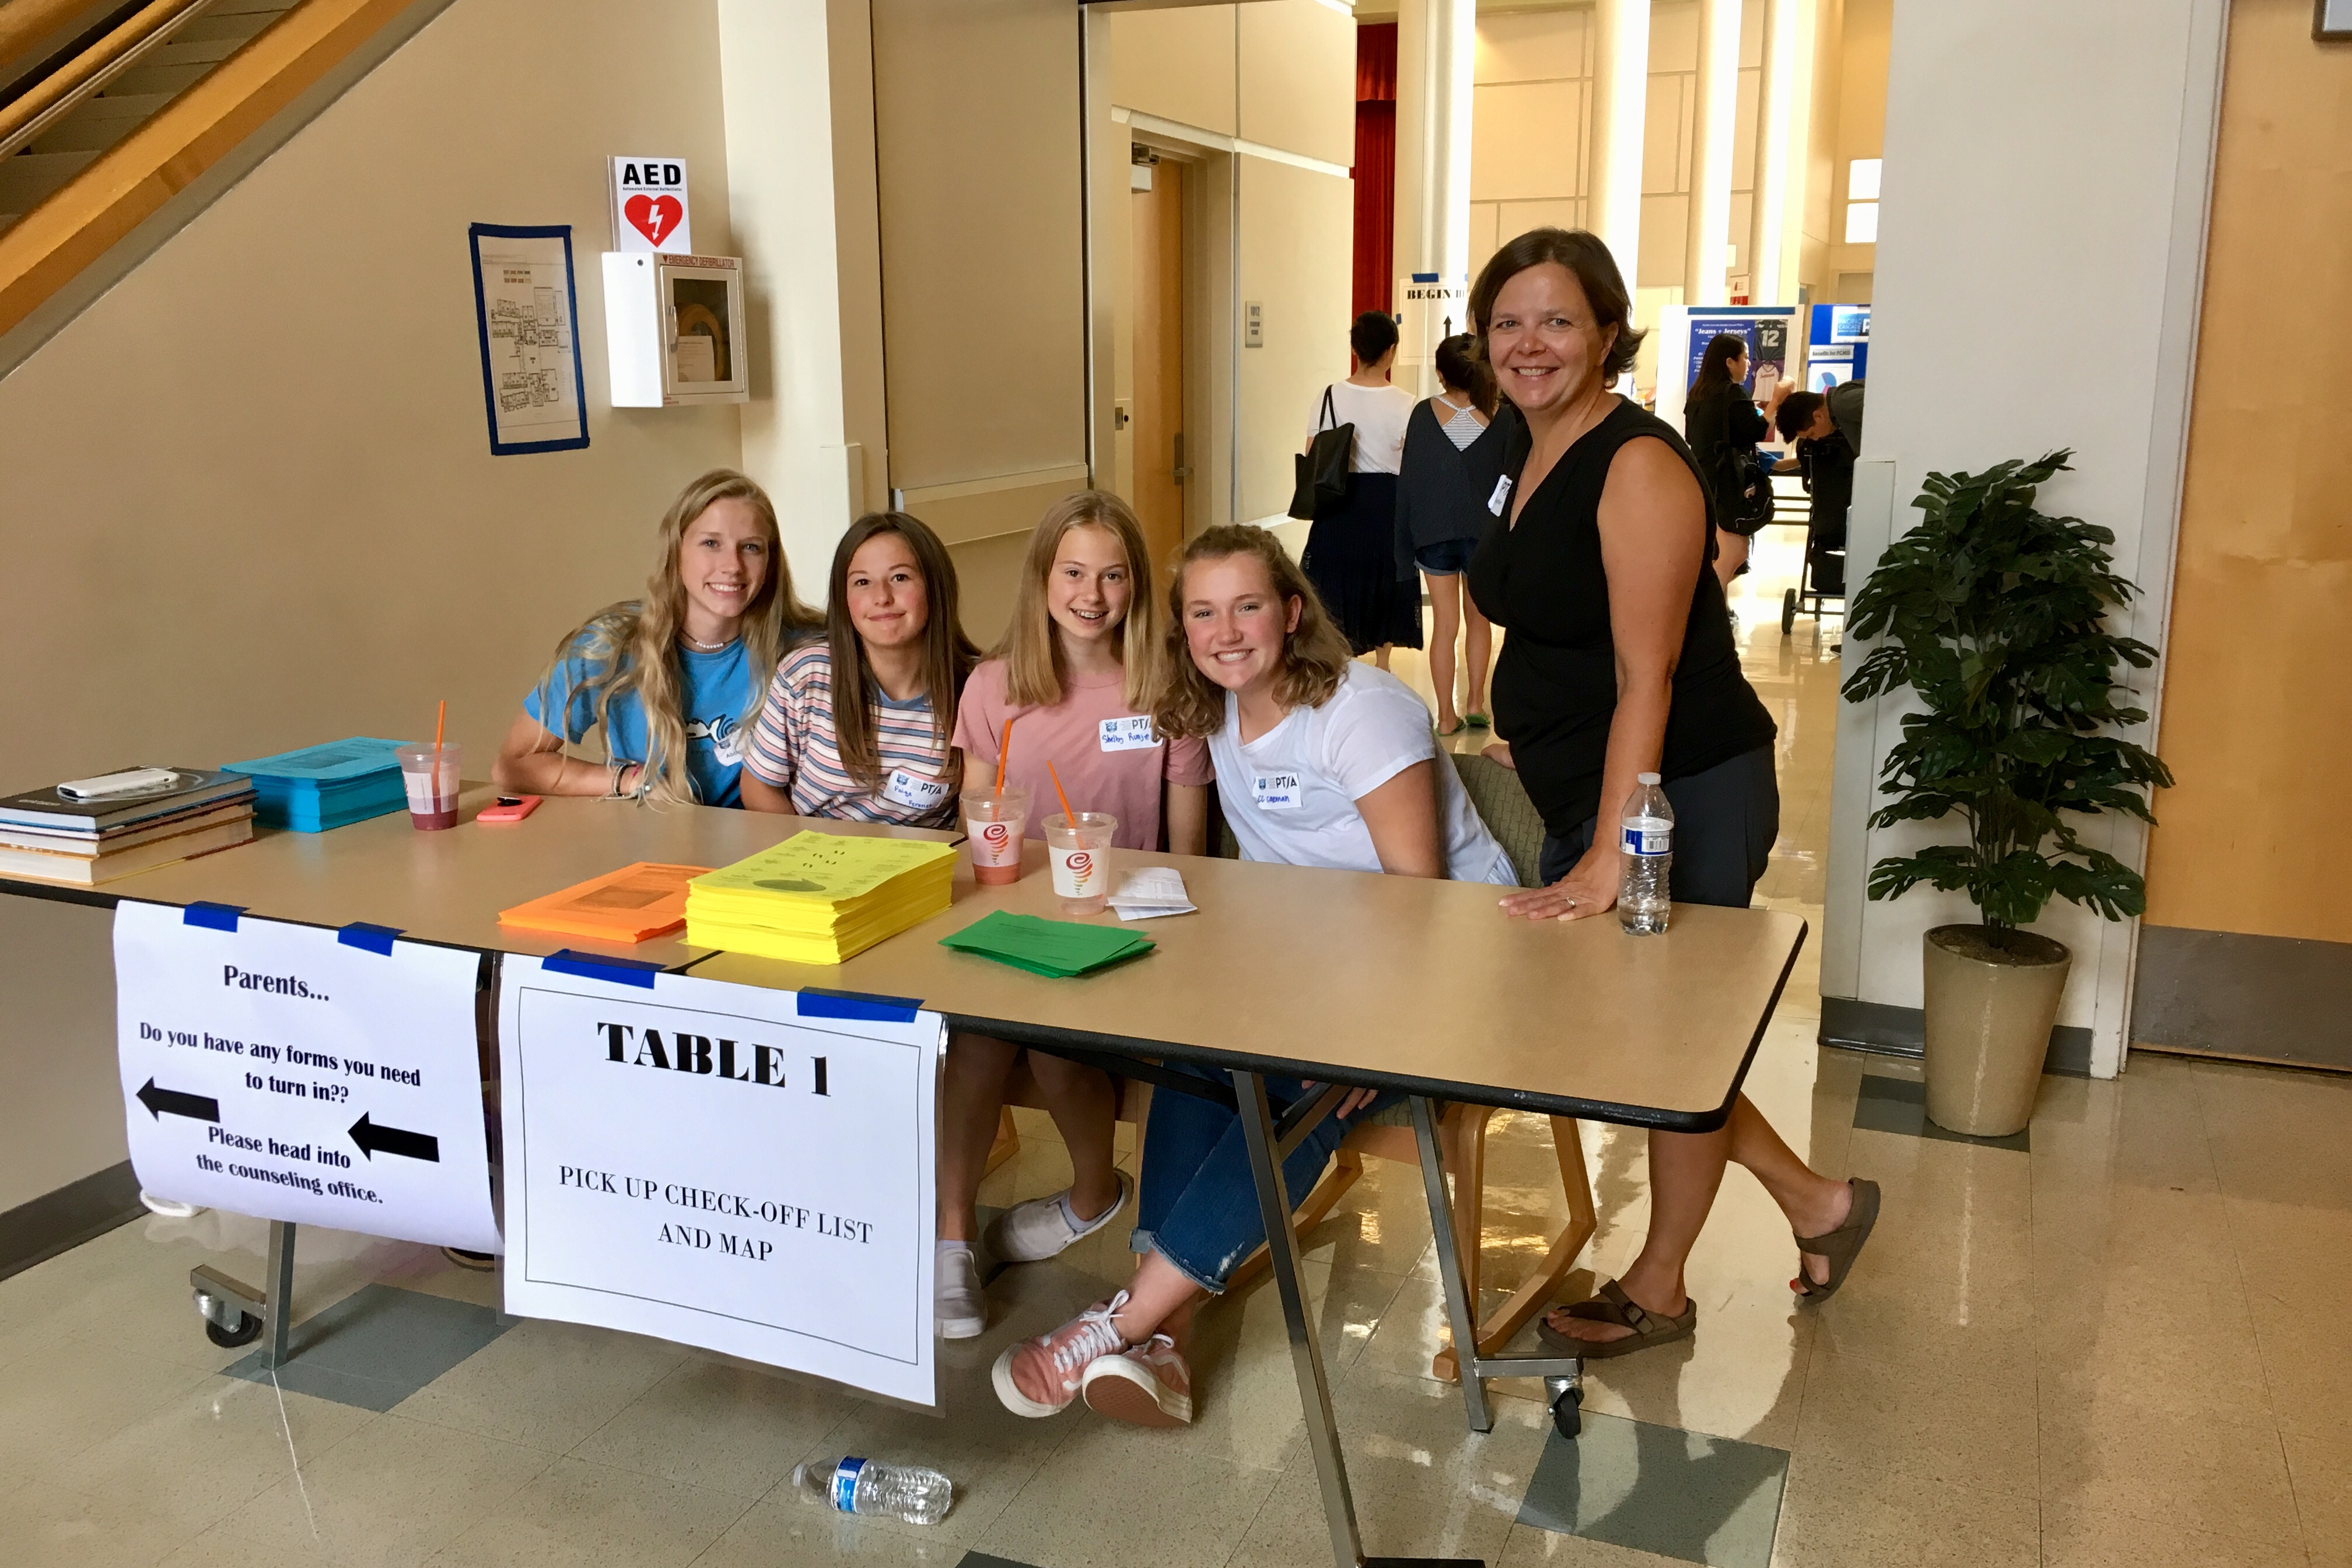
Presidents’ Report
Thank you to all of the Chairs and volunteers who have helped to start the year off right!
  Lynx Days – Chair Ann Taylor, and 70+ adult and student volunteers
  Bus Loading Helpers – Lisa Small and 7 volunteers
  Jeans + Jerseys Fall Social – Co-Chairs Jenny Juang and Josi Beck, and 27 adult and student volunteers
  Picture Make Up Day – 6 volunteers

Slide 7
President’s Report
PTSA Mission and Goals:
Mission: To create and foster opportunities that enrich and support our students, families, school, and community.
Goals:
  Encourage and create opportunities for family involvement in student academic learning and activities.
  Create a partnership with administrators, teachers, and staff to encourage an environment conducive to learning.
  Encourage opportunities for students to have a voice and advocate on their behalf when they don’t.
  Foster unity within our community through socials, meetings, and other events.

Slide 8
President’s Report
Changes to PTSA Standing Rules:
Section 12. Elected Officers; Executive Committee.
  Changed Vice President of Fundraising to Vice President of Volunteers.
Section 13. Officer Elections; Term of Office; Transfer of Power
  Eliminated April 30 deadline to elect officers to reflect WSPTA rule change.
Section 16. Board of Directors
  Eliminated Director of Events position.

Slide 9
Treasurer’s Report
July/August Highlights:
YE financial review completed in July – no findings.
There were no bank transactions in July 2018.
Income in August was primarily from Membership ($7,655) and Donations($10,860).
Expenses were primarily fees associated with accepting memberships and donations ($605.70 total from PayPal & Square).
There have been no claims against our insurance.
Bank statements will be reviewed monthly by Tracy Drake (a nonsigner on the account).

Slide 10
Treasurer’s Report
Approval of 2018-2019 Budget

Slide 11
Membership
Member Enrollment – CY 615 / PY 753
Membership Percentage – 61% (1,007 students)

Slide 12

ASB/Lynx Life
Popcorn/Cookie Dough Fundraiser

Slide 13
ASB/Lynx Life
Popcorn/Cookie Dough Fundraiser
  Volunteers will be needed to collect order forms, count and record money from orders, and deliver purchased products.
    Order Collection Dates are: Tuesday, October 2 and Tuesday, October 9
    Product pickup date is: Monday, October 29
  Volunteer signups will be published on PeachJar, eNews, and the PTSA website
Cascade Corner Student Store
Halloween School Social

Slide 14
Volunteers
Volunteers will be needed to support these school and PTSA activities in October and November:
Library Volunteer Coordinator
Manage and organize volunteer calendar and send schedule each month to the library volunteers
Library Volunteers
Reshelf books daily and help with book processing during the school lunches
Picture Retake Day – October TBA
  Check in students that want their pictures retaken
Vision & Hearing Screening – November 2 Chair Needed
  Assist the school nurse in conducting hearing and vision screens for our GR7 students
Holiday Gift Barn – November 26 – December 4 Chair Needed
  Collect donations of toys and clothing for the Issaquah Food & Clothing Bank’s holiday “shop” at Pickering Barn

Slide 15
Programs
Reflections
Student submissions due
  October 29:
  Visual Arts
  Photography
  Literature
  Music Composition
  Dance Choreography
  Film Production
PCMS Reception & Art Showcase will be Nov. 14
District Reception will be Jan. 15, 2019, from 6:30-8:00pm at Issaquah High School

Slide 16
Advocacy
Legislative Assembly
October 20-21, 2018
Green River College, Auburn
Delegates will vote on the new 2018-2020 WSPTA legislative platform. There are 5 proposed long-term resolutions, 2 proposed principles and 12 proposed short-term legislative issues. Legislative issues also will be ranked by delegates to determine a Top 5 for the 2019 and 2020 legislative sessions.
You can read the issues guide at: https://www.wastatepta.org/wp-content/uploads/2018/08/2018-Legislative-Assembly-Voter-Guide.pdf

Slide 17
Advocacy
Resolutions:
Improving Outcomes in Special Education
Mitigating the Health Effects of Climate Change
Equitable Access to Highly Capable Services
Sexual Violence and Harassment Prevention and Victim Supports
School Nutrition
Legislative Issues:
Best Practices for School Meals – Lunch
Engaging Families in Student Success
Fund Paraeducator Training
Increase Access to High-Quality Preschool
Safe School Plans and Emergency Preparedness
Strategies to Address the Teacher Shortage
Raise the Age of Tobacco and Electronic Nicotine Delivery Systems to 21
Best Practices for School Recess
School Construction and Simple Majority for Bonds
Prevent Gun Violence by Reducing Access
Social Emotional Learning
Strategic K-12 Investments to Close Gaps
You can express your opinions on these issues here:
https://www.wastatepta.org/wp-content/uploads/2018/09/2018-WSPTA-Legislative-Principles-Issues-and-Resolutions-Survey-v2.pdf

Slide 18

Issaquah Schools Foundation
All In For Kids Campaign
Dining for Kids
  October 3 - (Announcement Coming Soon - Save the date!)
  November 7 - Agave Cocina - Issaquah Highlands

Slide 19
Parent Education
ParentWiser is a parenting lecture series comprised of local and nationally-known experts who are invited to share the latest information in effective parenting with parents of the Issaquah School District.
Upcoming 2018-2019 Speaker Series events include:
  Habits for Middle School Success, Seth Perler
  Sept. 25 – Issaquah Middle School @ 6:30pm
  Sept. 26 – Beaver Lake Middle School @ 6:30pm
  Sept. 27 – Maywood Middle School @ 6:30pm
Attendance at ParentWiser events is free for PTSA Members of Issaquah District schools.
Register at ParentWiser.org

Slide 20

Parent Education
National PTA Resource
Find relevant and interesting articles in the National PTA’s magazine "Our Children," at http://ptaourchildren.org/
In this Fall’s issue, Barbara Oakley and Terrence Sejnowski, authors of the bestselling book “Learning How to Learn,” offer a few practical ideas—based on what we know from neuroscience—to help your children make the most of their education without spending most of their time studying. https://ptaourchildren.org/help-your-child-learn-how-to-learn/

Slide 21
New Business
Enrichment Grant Requests
Classroom Equipment:
 | 112 Privacy/Test Partitions |  | Henchen, McDonald, Honn |  | GR8 |  | $280.00
 | 4 standing desks/chairs |  | Potter |  | GR6 |  | $1,906.93
 | Science stools |  | McDonald |  |  |  | $1,820.40
Curriculum Enhancement:
 | Living History Performance |  | Honn, Fielden, Lozada, Summers |  | GR7 |  | $1,238.00
 | Museum of Flight "Under the Night Sky" |  | Hafner, Summers, Velloth |  | GR7 |  | $1,375.00
 | MOHAI Trunk Kits |  | Honn, Fielden, Lozada, Summers |  | GR7 |  | $80.00
 | HanaYama Puzzles |  | Nichols |  | GR6/7 |  | $94.08
 | Study.com subscriptions |  | Freidenfelt, Murphy, Hanky |  | ALL |  | $719.64
 | 9 RC Drones/4 Spare Parts sets |  | Summers |  | GR7/8 |  | $1,046.91
Other:
 | Bookopoly Prizes |  | Steirer |  | ALL |  | $327.00
 | Cricut Explore Air 2 |  | Steirer |  | ALL |  | $467.63
 | ALA Mid Winter Conference |  | Steirer |  | ALL |  | 439
 | TOTAL REQUESTS |  |  |  |  |  | $9,794.59

Slide 22
Adjourned.
Thank you for coming!

